Slide 1
Background Tasks
Android Developer Fundamentals
Lesson 7
This work is licensed under a Creative Commons Attribution-NonCommercial 4.0 International License

Slide 2
7.4 Services
This work is licensed under a Creative Commons Attribution-NonCommercial 4.0 International License

Slide 3
Contents
Services for long tasks
IntentService

Slide 4
Services is an advanced topic
Services are complex
Many ways of configuring a service
This lesson has introductory information only
Explore and learn for yourself if you want to use services

Slide 5
Services for Long Tasks

Slide 6

What is a service?
A Service is an application component that can perform long-running operations in the background and does not provide a user interface

Slide 7
What are services good for?
Network transactions
Play music
Perform file I/O
Interact with a content provider

Slide 8
Characteristics of services
Started with an Intent
Can stay running when user switches applications
Lifecycle—which you must manage
Other apps can use the service—manage permissions
Runs in the main thread of its hosting process

Slide 9
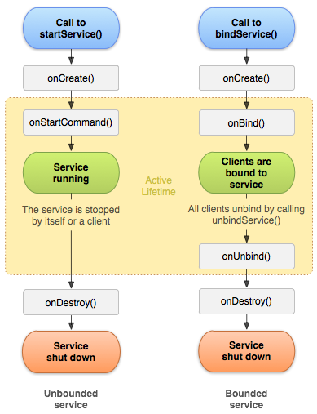
Forms of services: started
Started with startService()
Runs indefinitely until it stops itself
Usually does not update the UI

Slide 10
Forms of services: bound
Offers a client-server interface that allows components to interact with the service
Clients send requests and get results
Started with bindService()
Ends when all clients unbind

Slide 11
Services and threads
Although services are separate from the UI, they still run on the main thread by default (except IntentService)
Offload CPU-intensive work to a separate thread within the service

Slide 12
Updating the app
If the service can't access the UI, how do you update the app to show the results?
Use a broadcast receiver!

Slide 13
Foreground services
Runs in the background but requires that the user is actively aware it exists—e.g. music player using music service
Higher priority than background services since user will notice its absence—unlikely to be killed by the system
Must provide a notification which the user cannot dismiss while the service is running

Slide 14
Creating a service
<service android:name=".ExampleService" />
Manage permissions
Subclass IntentService or Service class
Implement lifecycle methods
Start service from activity
Make sure service is stoppable

Slide 15
Stopping a service
A started service must manage its own lifecycle
If not stopped, will keep running and consuming resources
The service must stop itself by calling stopSelf()
Another component can stop it by calling stopService()
Bound service is destroyed when all clients unbound
IntentService is destroyed after onHandleIntent() returns

Slide 16
IntentService

Slide 17
IntentService
Simple service with simplified lifecycle
Uses worker threads to fulfill requests
Stops itself when done
Ideal for one long task on a single background thread

Slide 18
IntentService Limitations
Cannot interact with the UI
Can only run one request at a time
Cannot be interrupted

Slide 19
IntentService Implementation
public class HelloIntentService extends IntentService {
public HelloIntentService() { super("HelloIntentService");}
@Override
protected void onHandleIntent(Intent intent) {
try {
// Do some work
} catch (InterruptedException e) {
Thread.currentThread().interrupt();
}
} // When this method returns, IntentService stops the service, as appropriate.
}

Slide 20
Learn more
Services Guide
Running a Background Service

Slide 21
What's Next?
Concept Chapter: 7.4 C Services
No practical

Slide 22
END

